Slide 1
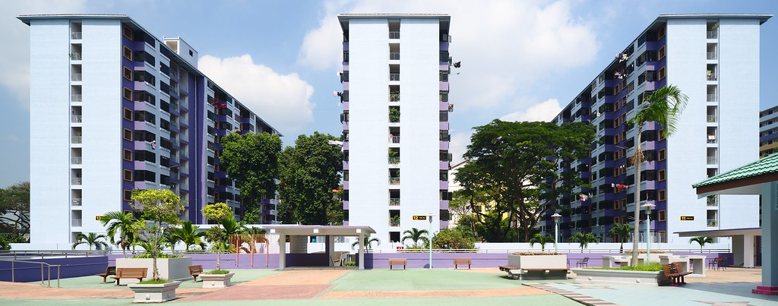
Property Statistics
SCTP Capstone 2

Slide 2

Agenda
Introduction to Dataset
Entity Relationship Diagram
Schema & Table Diagram
Data Cleaning
Data Analysis using PostgreSQL
Insights
Dashboard
Challenges

Slide 3
Introduction to Dataset
Descriptors | CEA Salespersons’ Property Transactions | CEA Salesperson Information
Origin of Data | Data.gov.sg (Council for Estate Agencies)
Dataset Size | 689,068 | 35,133
Format | .csv
Content | Local property transactions from Jan 2017 to Feb 2023 | Active property agents (until 2023) and their corresponding registered agencies
Scenario Background
Position | Property Analyst
Task | To review and analyse past transactions to propose future market position

Slide 4
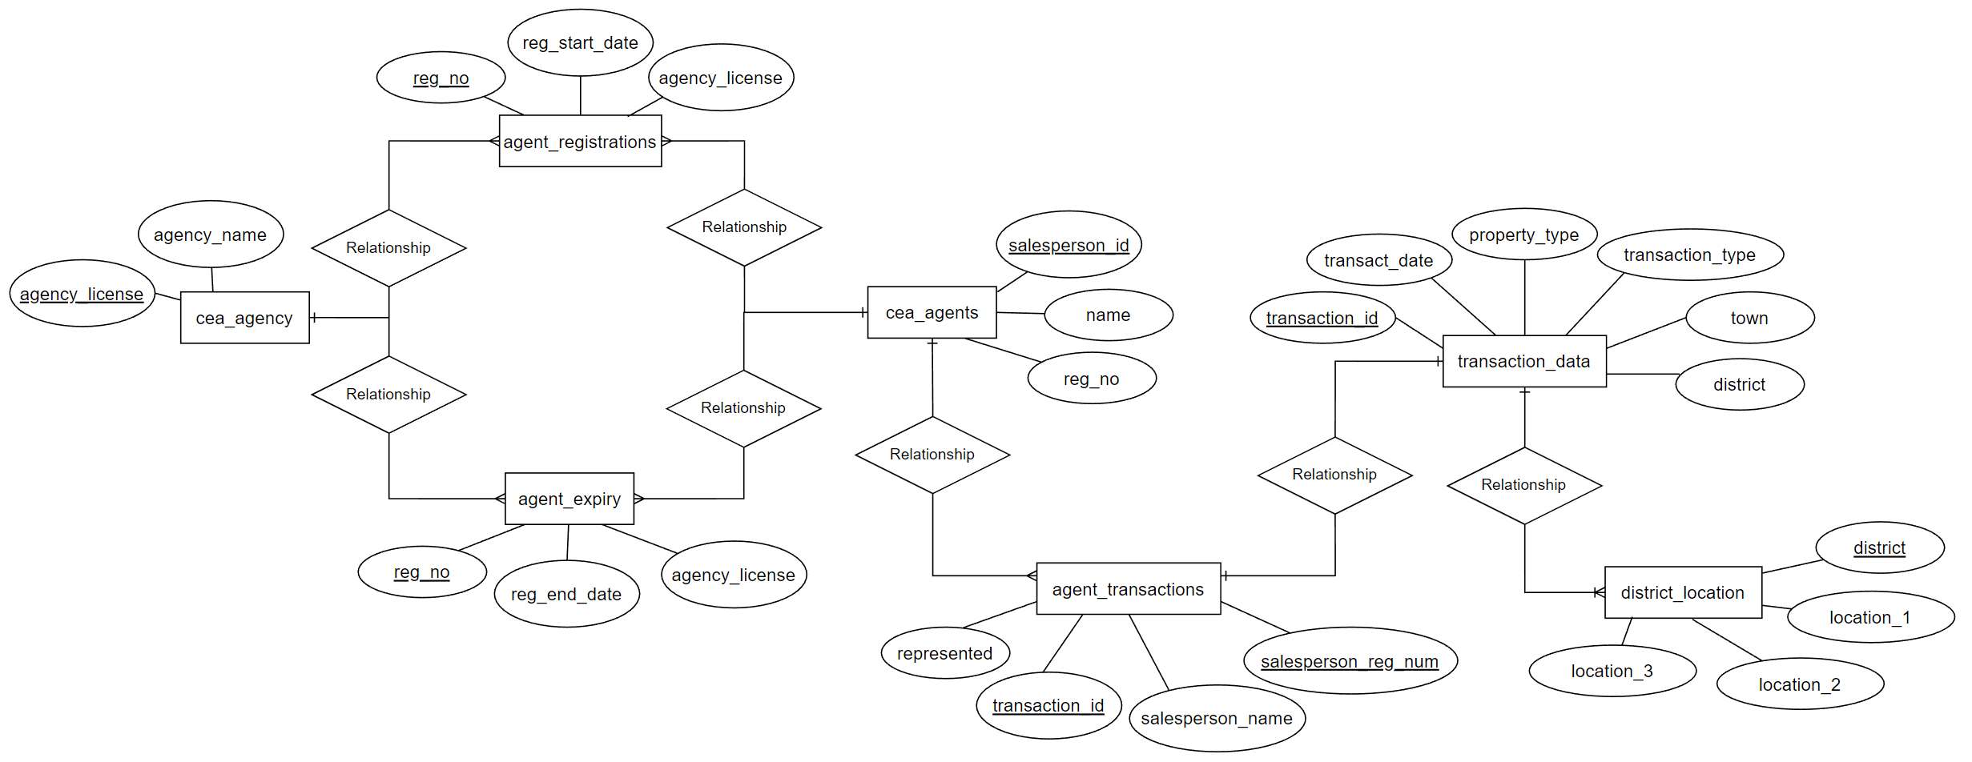
Entity Relationship Diagram

Slide 5
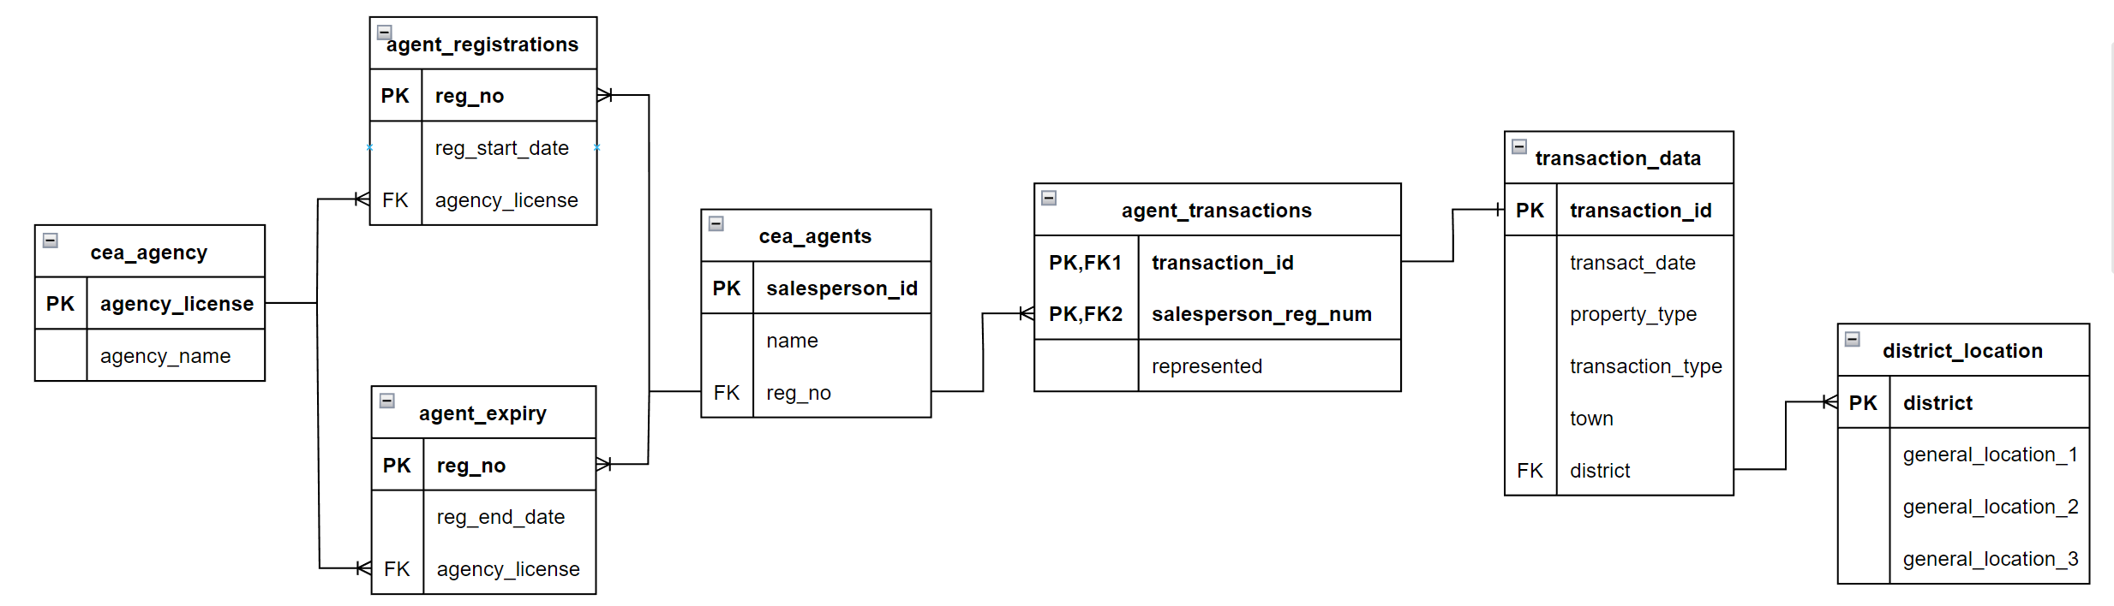
Schema & Table Diagram
CEA Salespersons’ Property Transactions
CEA Salesperson Information

Slide 6
Data Cleaning & Assumptions
Using Excel in csv format before importing into PostgreSQL .
Sorted salesperson_info by salesperson_name
Sorted transactions by latest transact_date
Using views when changing data types .
In salesperson_info, registration start and end dates from text to date using ::
In transactions, transaction date from text to date using to_date
Assume that duplicates seen in transactions are unique transactions .
Property agents can close multiple transactions in the same month within the same location and represent parties of the same and/or different category (i.e. seller, buyer)
Created transaction_id in transactions

Slide 7
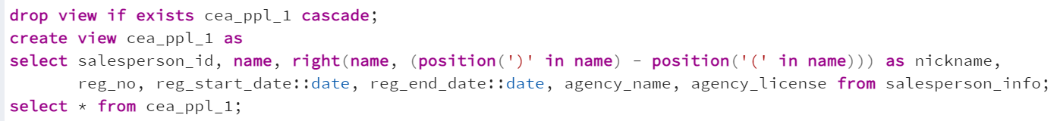
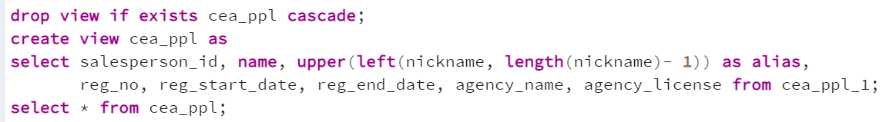
Using Views in PostgreSQL
Extracting the alias in between the brackets in 2 parts

Slide 8
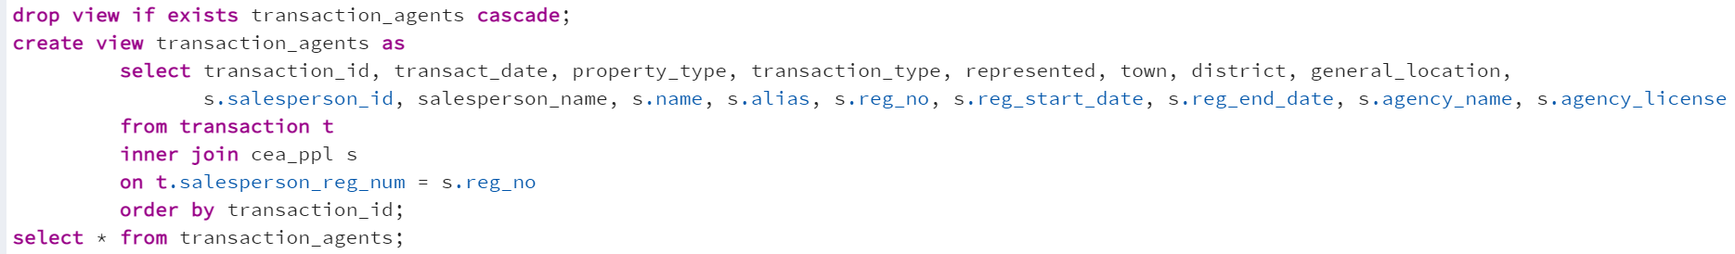
Using Views in PostgreSQL
Using an inner join to combine tables & extract transactions with an active agent

Slide 9
Data Analysis using PostgreSQL
What is the property type breakdown in Singapore?
What is the transaction type breakdown based on the representing party?
What are the top 10 most popular towns or districts?
What are the top 5 most popular property agencies?
Who are the top 5 property agents?

Slide 10

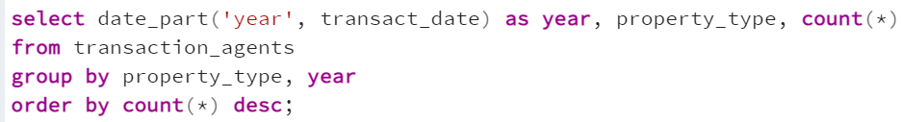
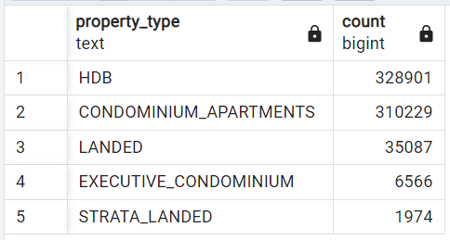
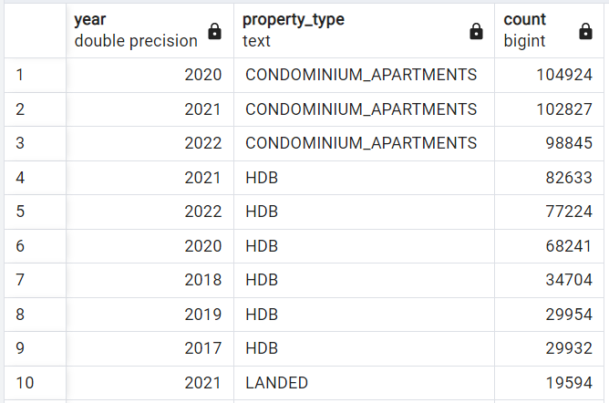
What is the property type breakdown in SG?
Insight! There may not be much difference (around 5%) in overall count of HDB and Condos but Condos are very popular in recent years, a very steep increase to compensate its non-existent or low transactions to come 2nd in rank.
Pandemic? Downgrading to save cost? Upgrading due to higher affluence? Renting out for extra income?

Slide 11
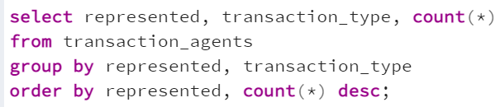
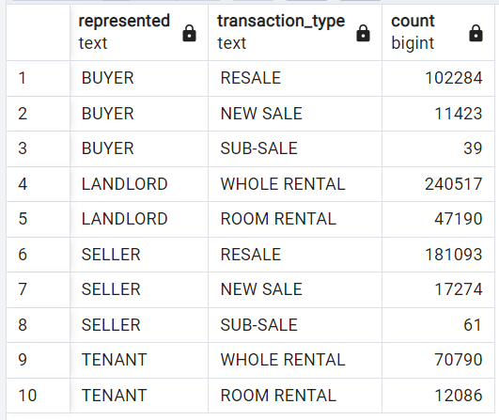
What is the transaction type breakdown based on the representing party?
Insight! High count for resale flats (both buyer and seller) as well as whole rental (higher possibility of it being from condos?)

Slide 12
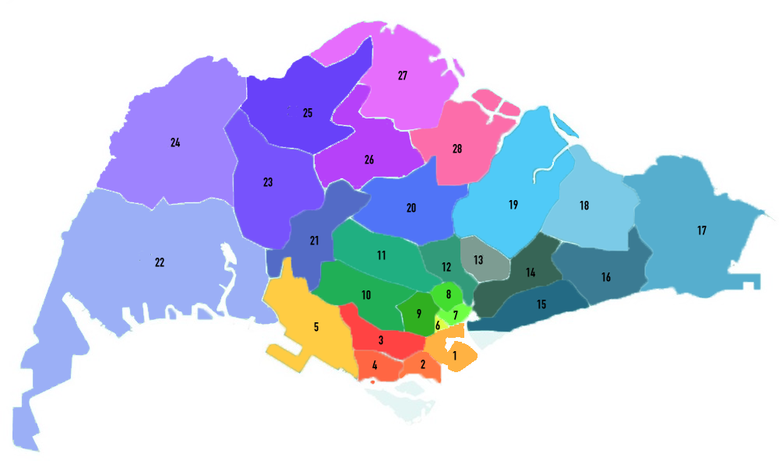
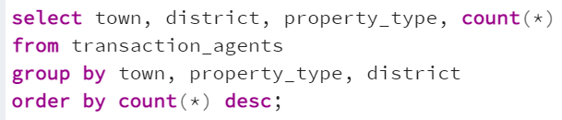
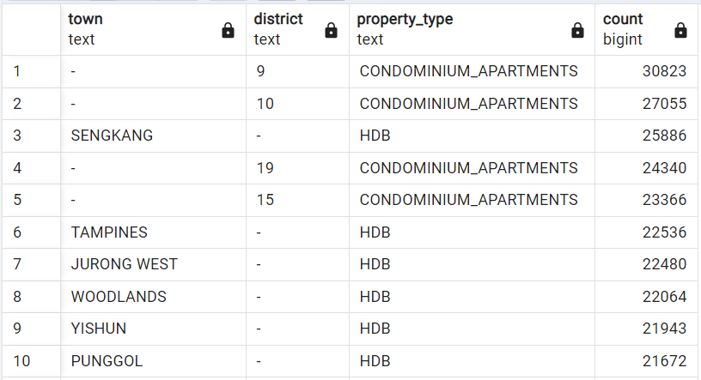
What are the top 10 most popular towns or districts in Singapore?
Source from https://www.redbrick.sg/blog/singapore-districts-and-regions/
Insight! Condos top the chart, probably because there’s a dominance of that specific type in those areas that happen to be in affluent central region.

Slide 13
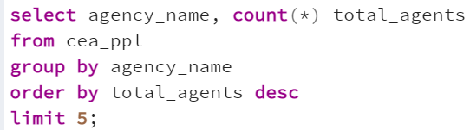
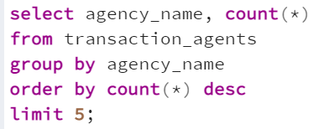
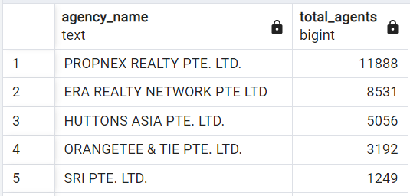
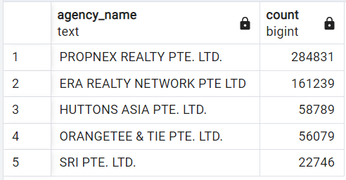
What are the top 5 most popular property agencies?
In Terms of Manpower
In Terms of Property Transactions
Insight! Quantity = Quality? .
Propnex has the most number of agents which reflects their high number of transactions. On average, each agent closes 23 transactions.
.
Interestingly, the ranking remains the same for both.

Slide 14
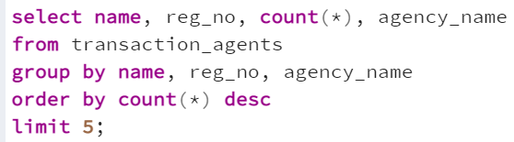
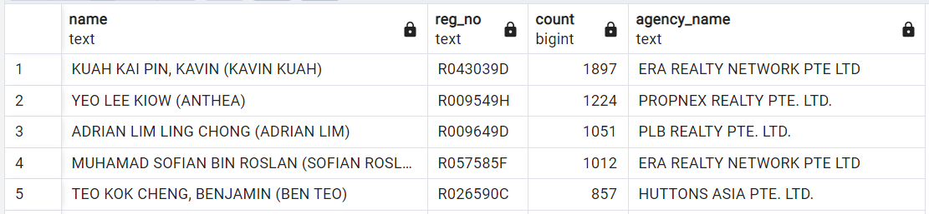
Who are the top 5 property agents?
Insight! Quantity = Quality? Maybe not… .
Despite Propnex topping charts, ERA seems more successful in their transactions per agent count.
.
Interestingly, there’s a tanker amongst the ranks (PLB).

Slide 15
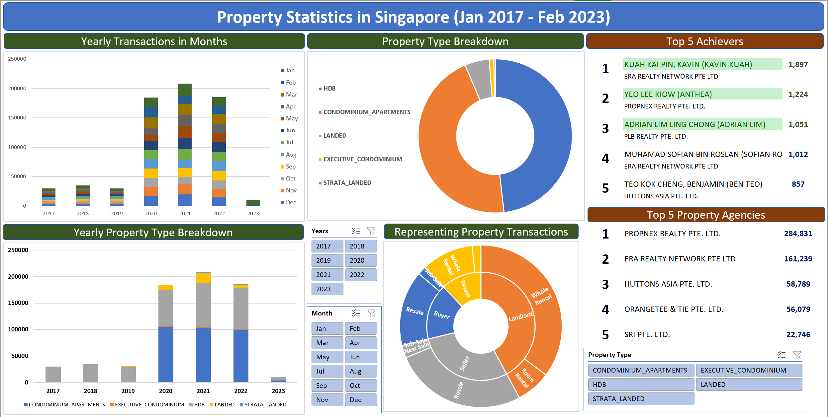
Continued focus on HDB market due to announcements of new BTO flats
Condos will continue be in popular demand with 3 strong years high
To include housing types (i.e. rooms) for more holistic analysis
Possibility to include sales to analyse the value of the market

Slide 16
Challenges
Because coding is tough

Slide 17

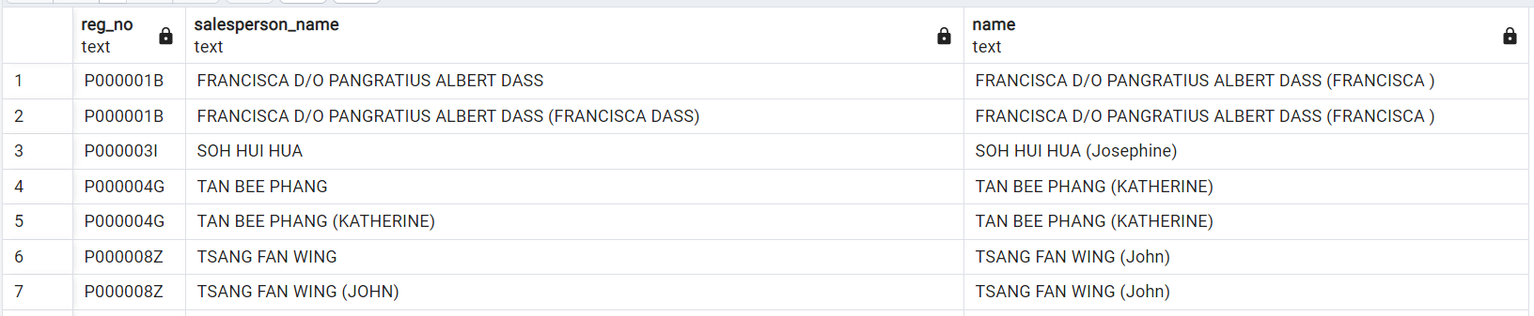
Problems with salesperson_name
Assumed that salesperson_name is more consistent than name
salesperson_name is from transactions table which would require using real names instead of aliases
Thinking that transactions table is more ‘official’ than the CEA salesperson information table
Reality? Name from CEA salesperson is more consistent with their agent names and aliases

Slide 18
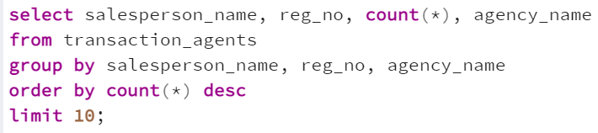
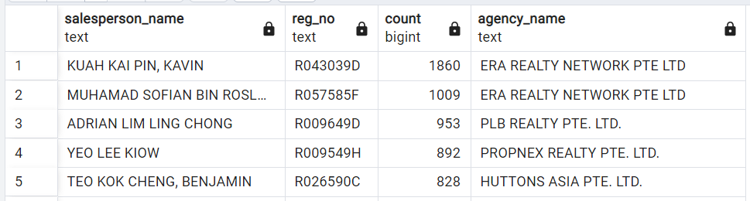
Impact? Affected total transaction count
Using salesperson_name
Using name

Slide 19
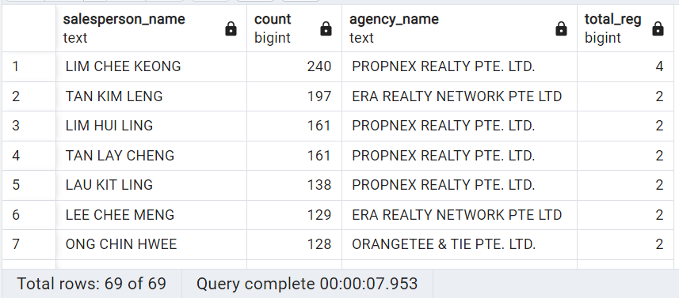
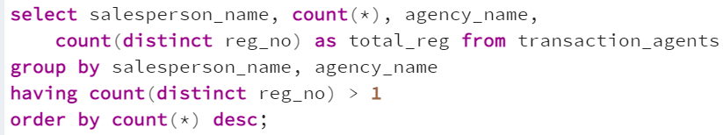
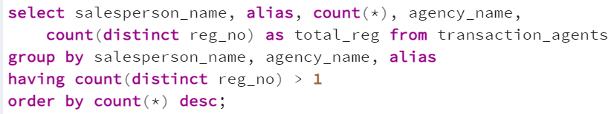
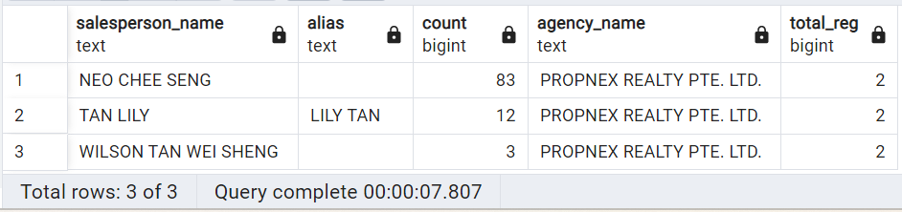
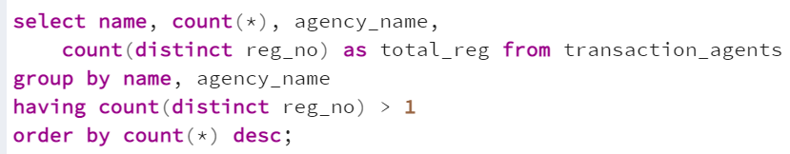
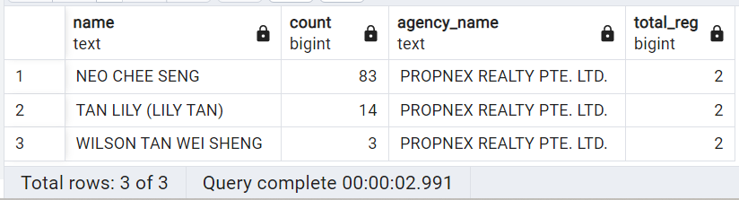
Impact? Additional steps

Slide 20

This Photo by Unknown Author is licensed under CC BY-SA

